Slide 1

Front-End Mini Project1
Desi Restaurant Website
By Magi Sri Bhargavi

Slide 2
PROJECT IDEA
Desi Restaurant is a non-veg restaurant , which will deliver the a huge variety of delicious dishes and desserts.
Website consist of menu, reviews of user ,online ordering option, online registering option
The website is user-friendly and is compatible on different browser.
The website is allow users to register and order food online .

Slide 3
TECHNOLOGIES USER
HTML5
CSS
JAVA SCRIPT

Slide 4
LESSONS LEARNED
Desi Website – This is my first mini project
There were some design challenges like improve responsive header / navbar with toggle menu bar effect and search bar icon.
Most things take longer than expected
Many more functionalities are yet to be implemented.

Slide 5
The main feature of this website are:
responsive header / navbar with toggle menu bar effect and search bar icon
responsive home section with touch slider using swiper.js
responsive dishes card section using grid
responsive about section using flexbox.
responsive menu card section using grid.

Slide 6
responsive review section with touch slider using swiper.js
responsive order form section.
responsive footer section using grid.

Slide 7
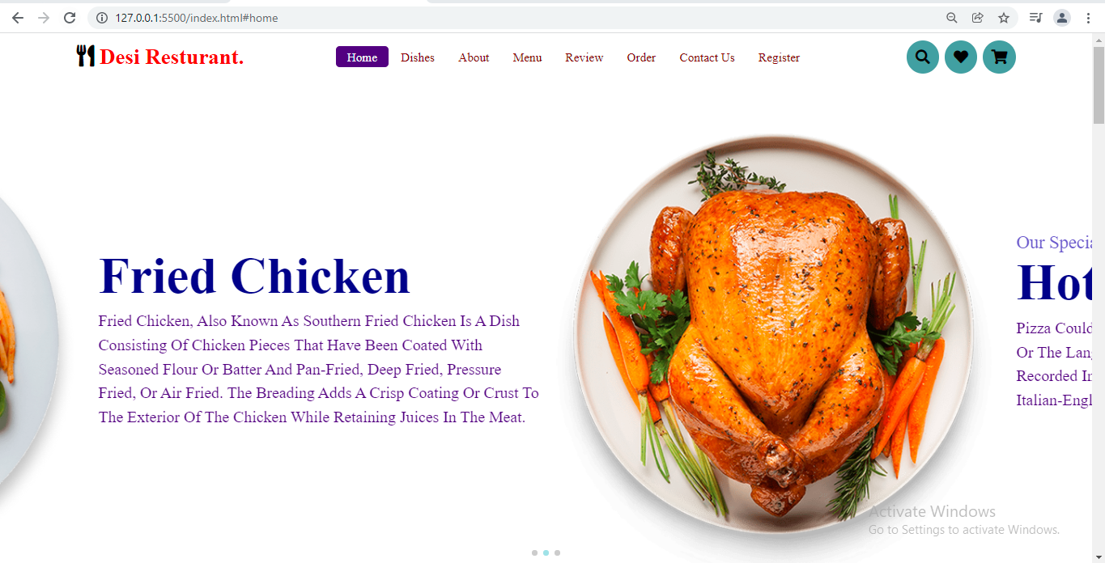
This is the Home page of the website of desi restuarant

Slide 8
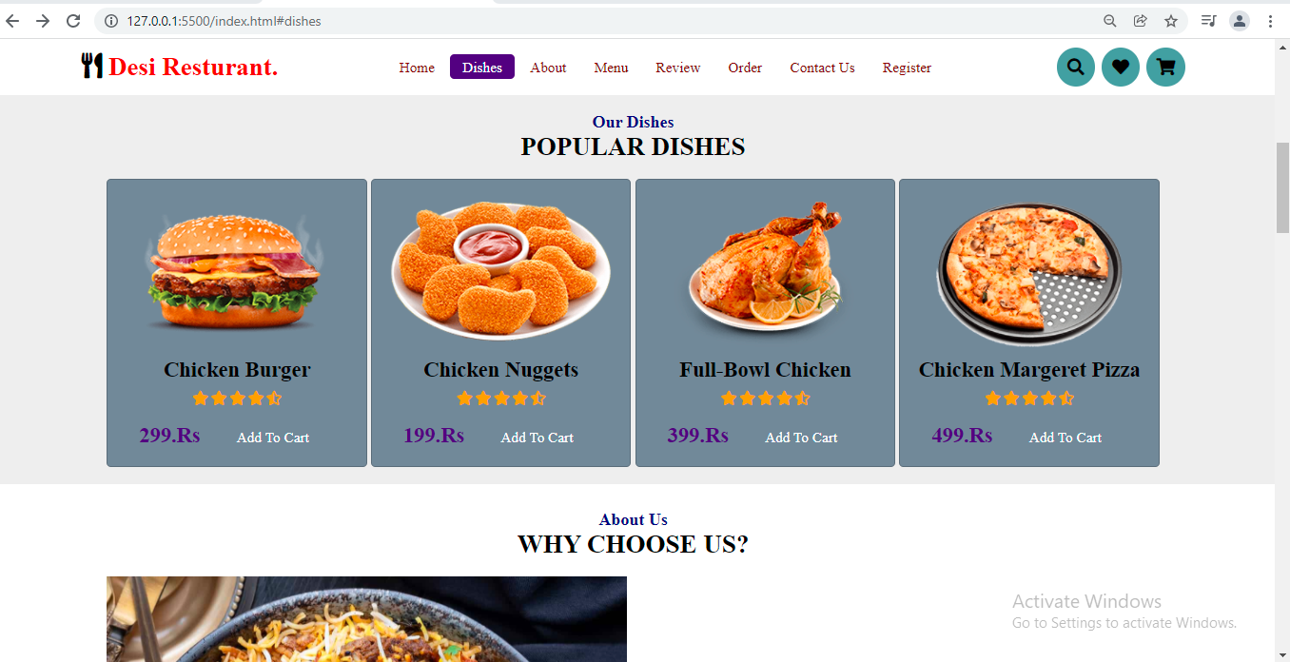
This is the Dishes tab, which is consists of a variety of popular dishes

Slide 9
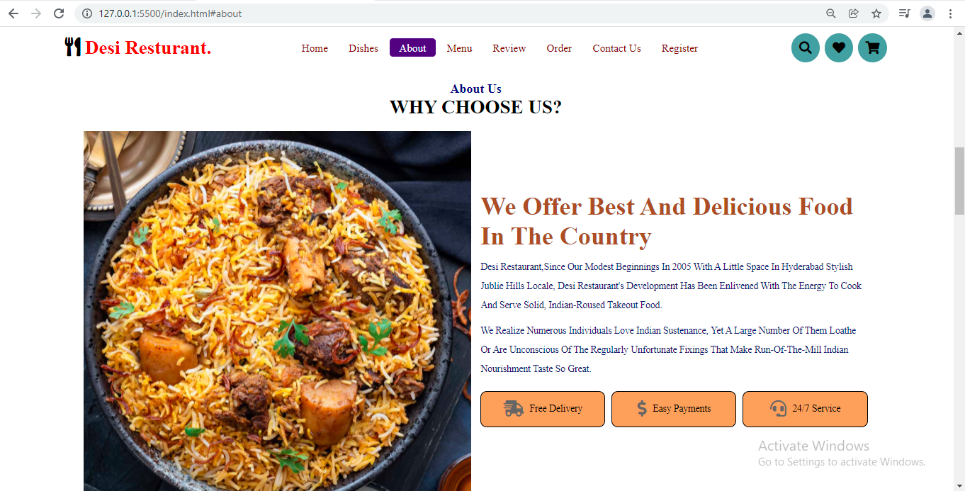
This is the About Us tab, give glimpses about the desi restaurant.

Slide 10
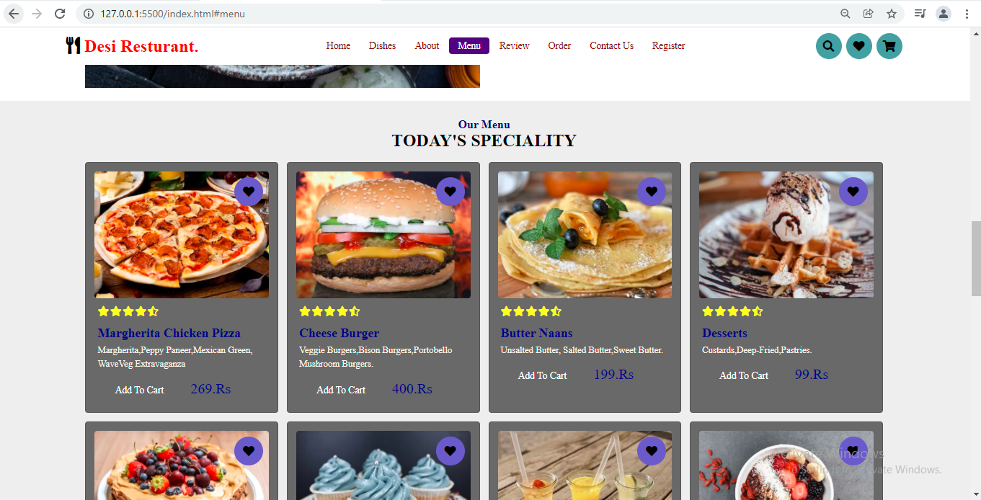
Menu tab is consists of every day's special dishes list

Slide 11
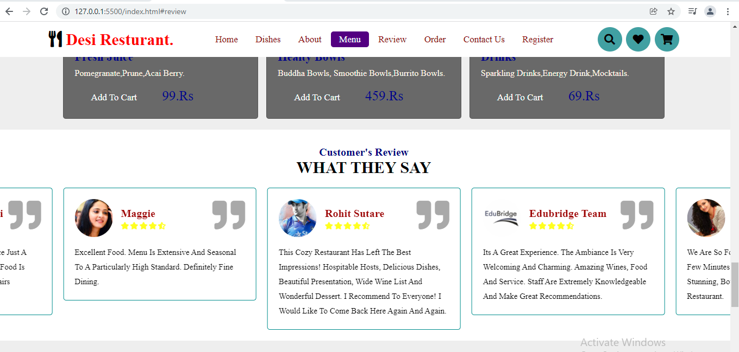
Here is the review slider bar , by using swiper.js we have reviews as slider bar. These reviews are given by the end users

Slide 12
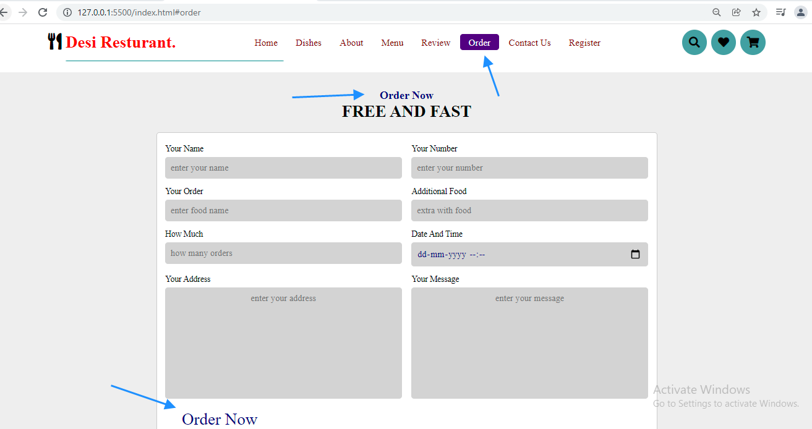
Order form is helps to order your favourite food online

Slide 13
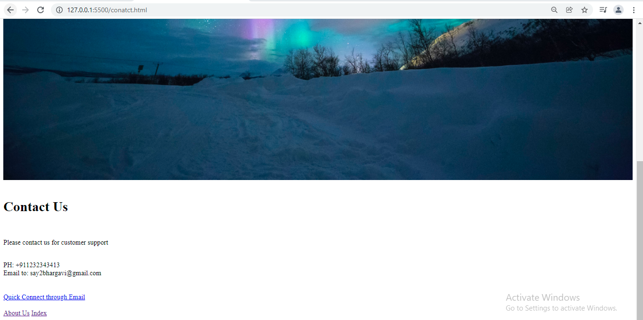
This is the contact us page , here you can contact customer support and can redirect to the home page by clicking on about us

Slide 14
register
The register option page has features like name , user name, email ID , password , confirm password.
The user can create an account by giving name , user name, email ID , password , confirm password.
Once the create account button clicked , the user credentials will get validated and redirects to home page of desi restaurant.

Slide 15
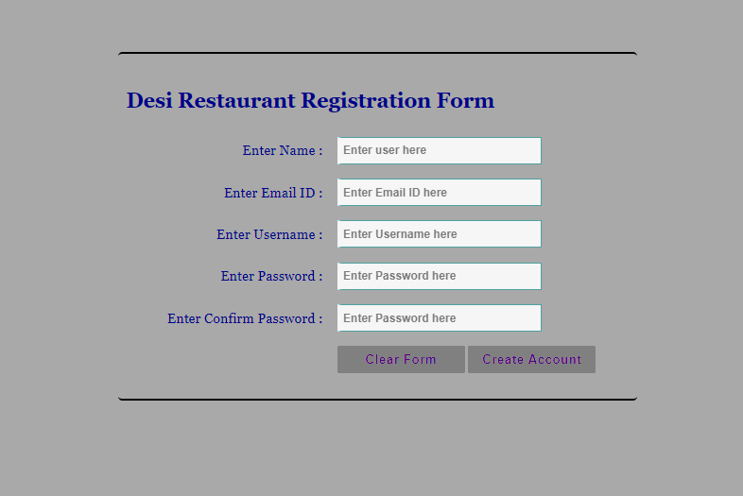
Register form

Slide 16
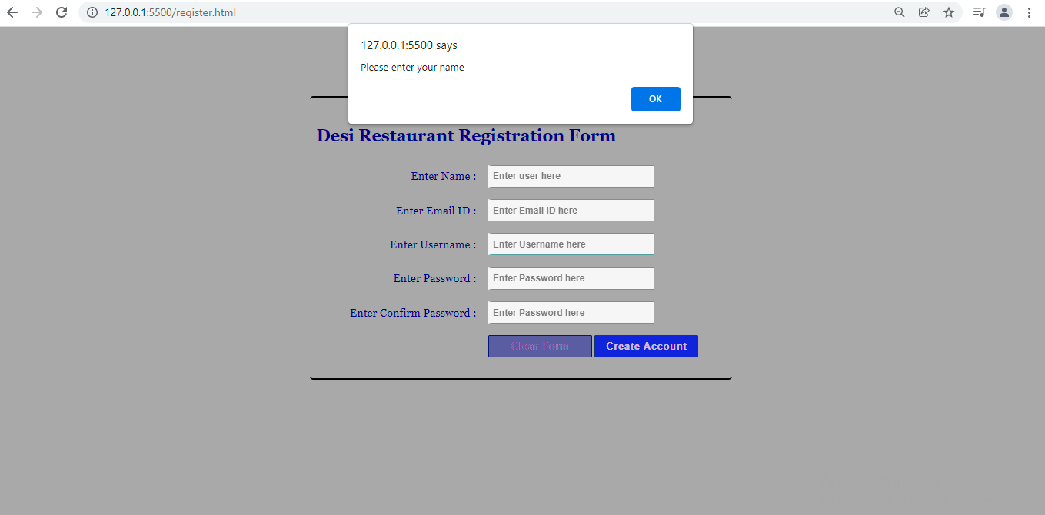
When the text filed of name is empty , it is giving the alert as enter name

Slide 17
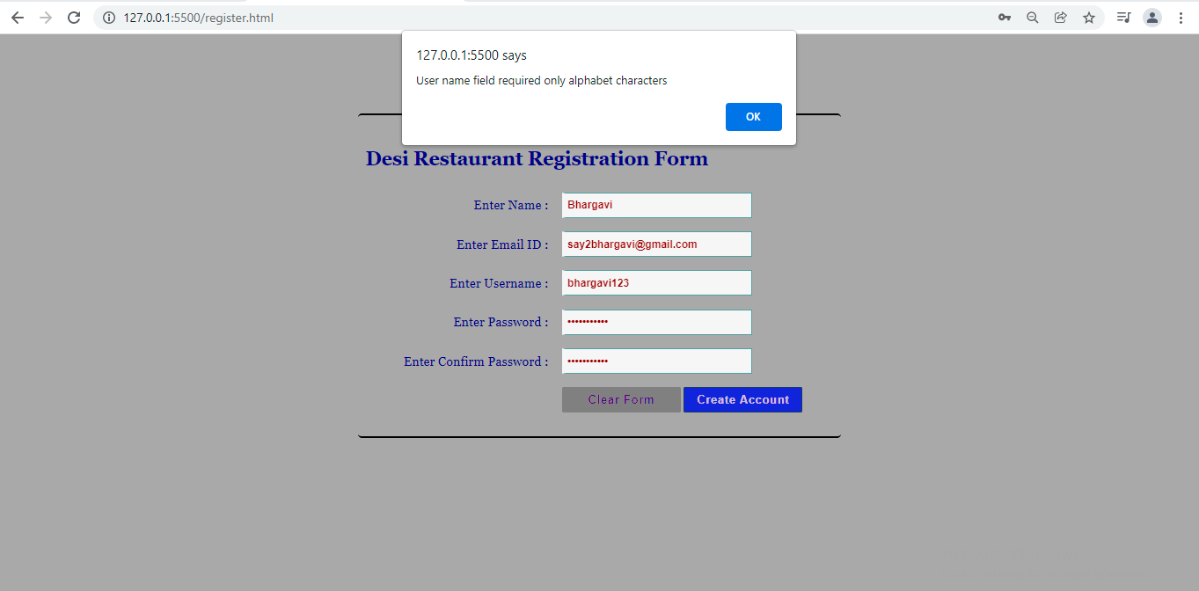
Getting alert as user name contains only alphabets

Slide 18
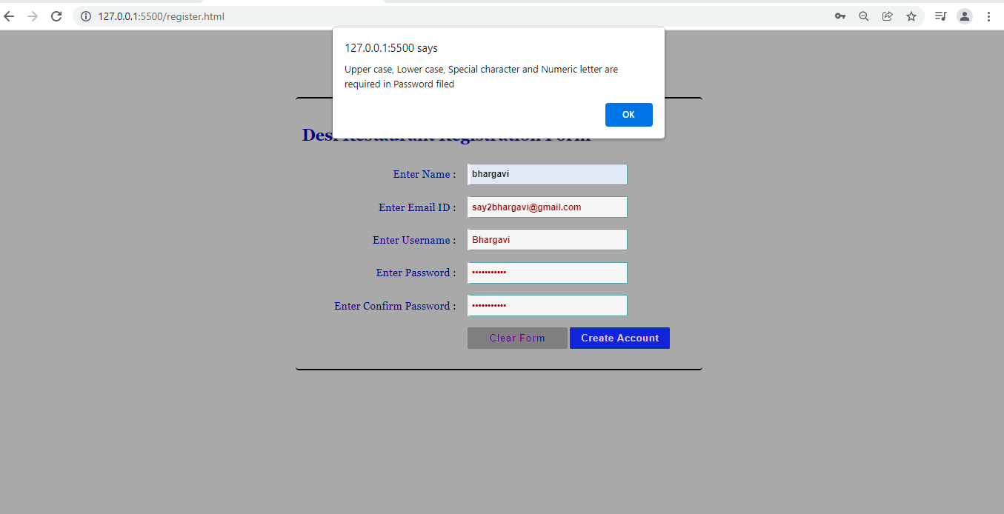

Slide 19
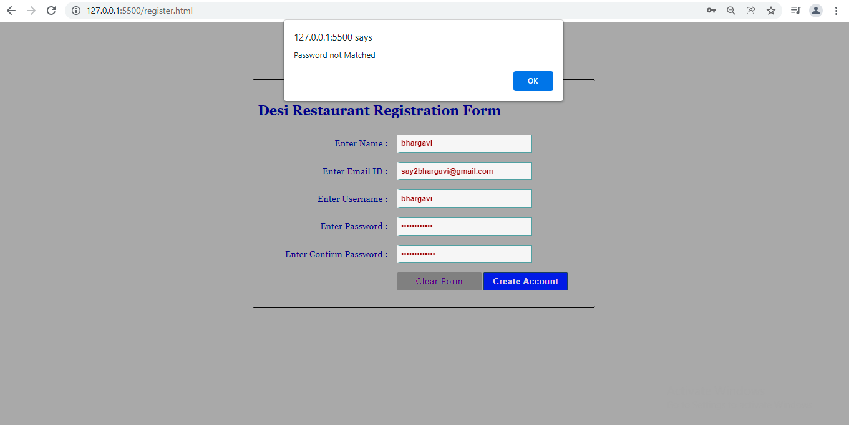
Validation of password filed is giving alert as both password should match

Slide 20
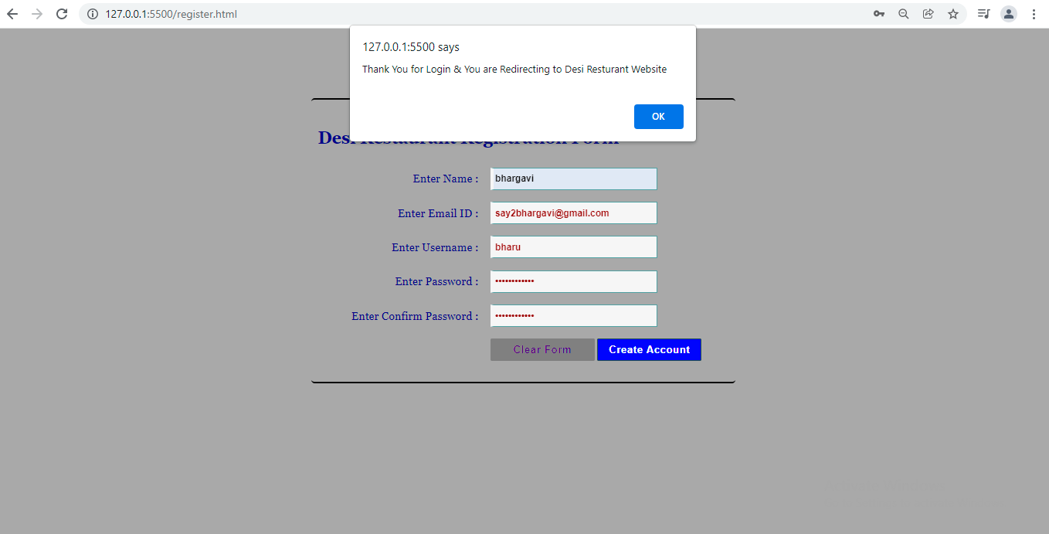
After giving all the details ,click on create account button, so it will give alert as it is “redirecting to desi restaurant website”

Slide 21
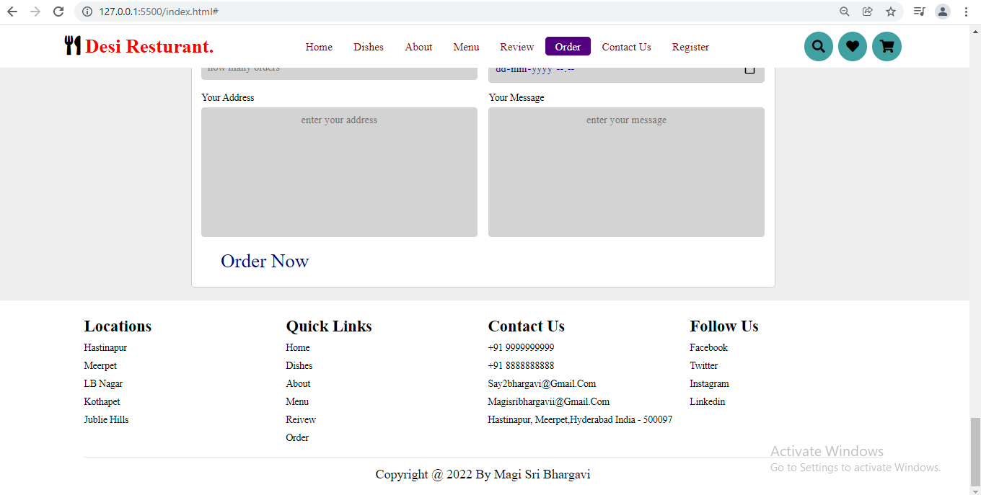
Footer tab is consists of Locations, Quick links ,contact us , and social media links

Slide 22

This is the loader class , here we can give images , GIFs etc. we have added the gif file in the domain so when ever we refresh or loading the the page we can see the gif file is playing

Slide 23

Thank you

